Slide 1
Indexing Social Care Datasets for Research
Dave Clark¹
1 eData Research & Innovation Service (eDRIS) - NHS National Services Scotland
- on behalf of National Records of Scotland (NRS)
New Register House, Edinburgh
28th June 2018

Slide 2
Indexing of Health and Social Care Data
Role of NRS Indexing Service
“Read-through” Indexes
Indexing Health Data
Linking data with no names
Indexing Social Care Survey
Indexing Care Home Census
Discussion

Slide 3
Overview of Indexing Service
Trusted Third Party for Scottish Informatics Linkage Collaboration (SILC)
One of SILC shared services supporting ADRC-S, Farr Institute Scotland, Scottish Government and Urban Big Data Centre
Work closely with other shared services – eDRIS Research Co-ordinators, EPCC Safe Haven

Slide 4
Linkage Resources
Small team – 3 “Indexers”
Increasing workload and complexity!
NRS Indexing Research Spine
Based on NHS Central Register (NHSCR)
Approx 9M individuals (Births, GP registrations, Deceased people)
Name and postcode histories
Linkage tools
BigMatch, Quality Stage, Bespoke SAS/Fortran etc
Managed Secure File Transfer

Slide 5
Linkage Processes
Separation of Functions
Indexing Team see no payload data
Spine Matching
Deterministic and Probabilistic methods
Index numbers replace local IDs
Master Index of all dataset indexes per project
Summary Reports
For researchers / research co-ordinators
Data quality, linkage quality (precision, link rates)
Potential biases (age/sex/deprivation)

Slide 6
Study Environment for a Linkage Project

Slide 7
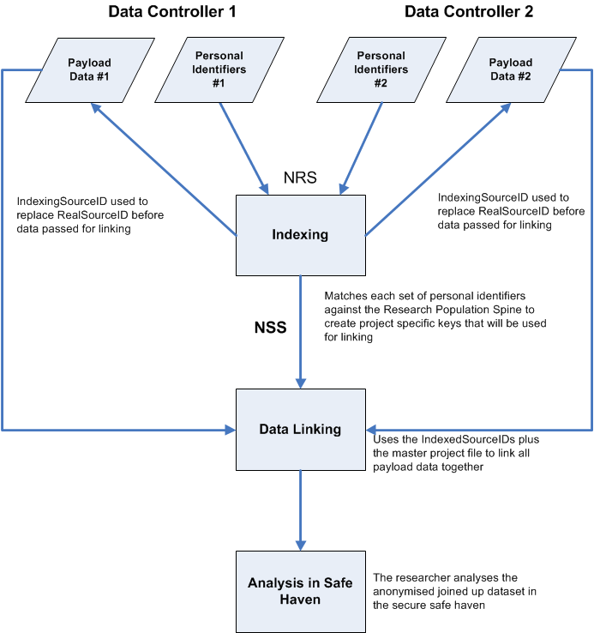
Separation of functions
Data Controller’s Unique Reference Number (SourceID) and PII transferred to NRS Indexing Team
SourceID and IndexedSourceID transferred to Data Controllers
Researcher accesses linked de-identified data in a safe setting
Master lookup file transferred to the Linkage Agent to allow the IndexedSourceIDs from each dataset to be linked
NRS indexing team create the Master Index File which links each IndexedSourceID
Match PII to the Research Population Spine. Randomly generated IndexedSourceIDs assigned to all records
IndexedSourceID and Payload Data transferred by Data Controllers to the Linkage Agent

Slide 8
Read-through Indexes
Re-use of previous indexing
Minimises volume of personal identifying data transferred
Minimises processing of personal data
Efficiency savings for Indexing Team
Not about maintaining permanent datasets
Data controllers still need to provide explicit approval project-by-project

Slide 9
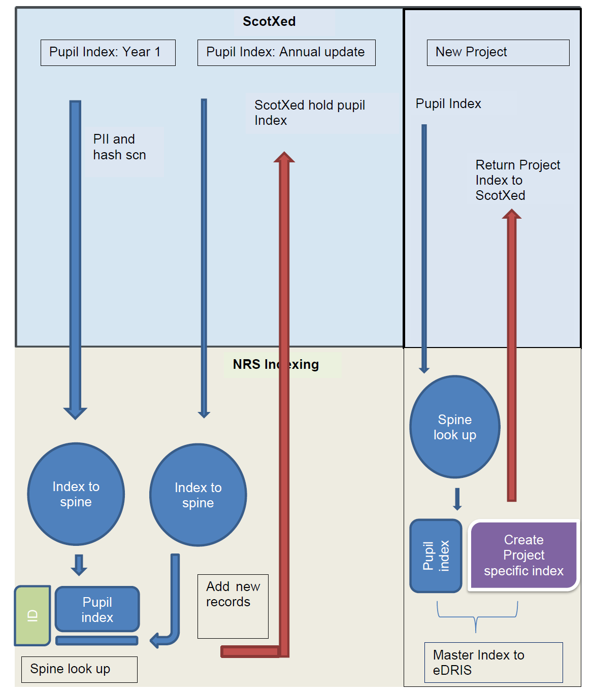
Read-thru Process
First indexing establishes read-thru
NRS hold Read-thru – Spine lookup
Data controller hold Local_ID – Read-thru lookup
Only Read-thru and project indexes exchanged in new projects

Slide 10
Indexing Health Data
Centrally held datasets at NHS NSS contain CHI numbers at source.
Automatic CHI-seeding process to add, correct or confirm CHI number and update CHI UPI.
ISD Indexing Service achieved 99.9% in both precision and sensitivity measurements in 2015 linkage quality evaluation.
NRS Indexing have a lookup between SpineID and CHI UPI.

Slide 11
Linking data with no names
School pupil census successfully matched, without names, to CHI and NRS Indexing Spine.
Approx 99.5% of pupil records match to Spine with 98% precision.
Problem of same-sex twins in pupil cohort mean 2.2% exact match to a rival SpineID.
Up to 95% of pupil records exact match uniquely to a single SpineID.
> 98% of DOB/Sex/Postcode combinations on the Spine are unique to a single SpineID.

Slide 12
ScotXed Linkage Methodology
Pairs blocked on Sex + Postcode or Sex + DOB.
Probabilistic weights for linkage fields calculated as per ISD MRL system.
YOB, MOB, DYOB, SEX, POSTCODE
Individual field weights summed to give overall record pair comparison score.
Delta weight of difference in score with nearest rival SpineID used to categorise matches.

Slide 13
Unique Exact Matches
94.8% of latest pupil census categorised as unique exact matches against Spine. These matches have estimated precision >99.9%.

Slide 14
Tied Exact Matches
2.4% of latest pupil census categorised as tied exact matches against Spine. These matches have estimated precision ~50.0%.

Slide 15
Mis-matches on last character of postcode
0.7% of latest pupil census categorised as mis-matches on last character of postcode against Spine. These matches have estimated precision ~92.5%.

Slide 16
Other matches and non-links
1.0% of latest pupil census categorised as other matches (mis-matches in one element of Date of Birth, or last 2 characters of postcode) against Spine. These matches have estimated precision ~70.0%.
1.1% of latest pupil census categorised as non-matches against Spine. Approximately 1/3 of the best matching SpineIDs may actually be true matches.

Slide 17
Indexing Social Care Survey
Home Care Survey (2010-2012), Self-Directed Support Survey (2010-2012) and the Social Care Survey (2013-2016).
594,380 SCS records (488,185 unique ClientID).
ScotXed provided Encrypted ClientID with unique combinations of Date of Birth, Sex & Postcode for matching to Spine.
ClientID may not be replicated for same client within a Council Area, and certainly not across council areas.

Slide 18
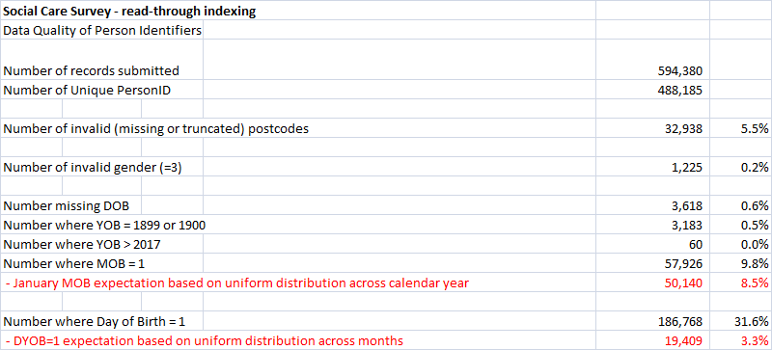
SCS – Data Quality Issues

Slide 19
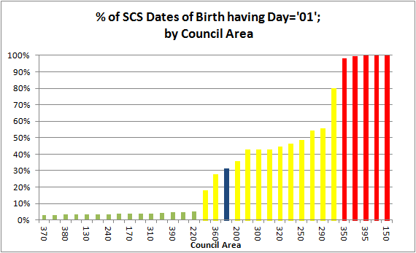
SCS – Data Quality Issues

Slide 20
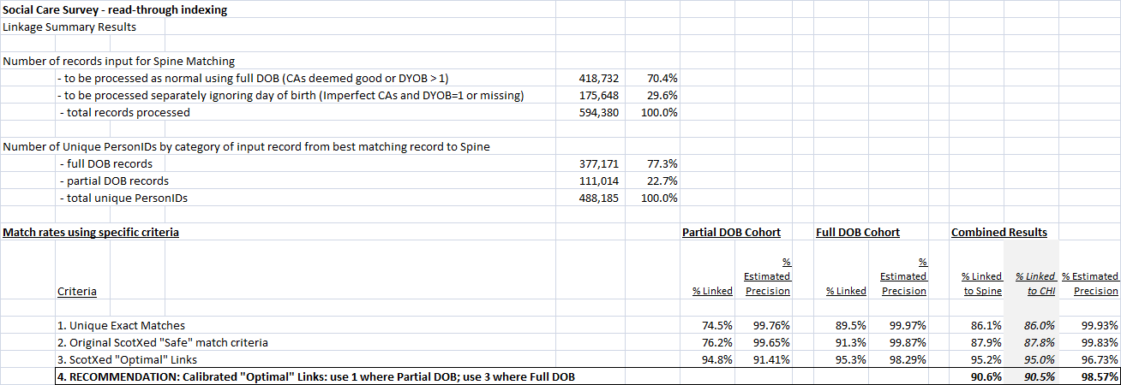
SCS Linkage Results
Calibrated Optimal Criteria: Only unique exact matches where Council Area known to submit truncated DOB, otherwise ScotXed match criteria is used

Slide 21
SCS Linkage Results by Sex & Age
Overall Spine match rate = 90.6%
Tied rival SpineID = 1.4%
Male: 90.4% v Female: 91.0%
Year of Birth
1930-1960 consistent match rate between 92% to 93%

Slide 22
SCS Linkage Results by Council Area and SIMD
Highest: Angus and D&G = 98.5%
Lowest: Clacks Council = 1.0%
Due to truncated DOB & Postcodes
North Lanark = 76.7%
No apparent pattern by SIMD decile
Decile 1 (most deprived) = 94.4%
Other deciles in range 93.2% to 93.9%
Unassigned SIMD = 19.1%

Slide 23
Indexing Care Home Census
Care Home Census data provided in 2 waves (2012/13 - 2015/16) and (2010/11 – 2011/12) as part of eDRIS project 1516-0438 – “Admission to a care home from hospitals across Scotland”.
Earliest data tackled last because no names
Uses ‘ScotXed methodology’
Improving data quality in later years.
Postcode information based on Care Home rather than previous residence.

Slide 24
Care Home Census 2012-16 Data Quality
146,152 Input Records
~100% - valid postcode
99.9% - valid gender
94.5% - valid DOB
3.8% DYOB= ‘01’ c.f. 3.3% expected
88.9% - filled names
however includes many initials only
88.7% - valid DOB/Sex/Pcode/Names

Slide 25
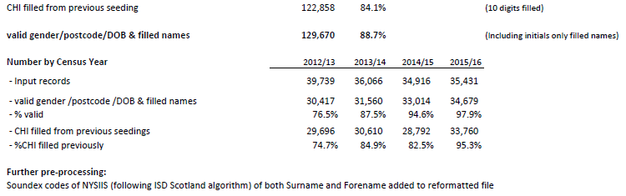
Care Home Census 2012-16 Data Quality continued

Slide 26

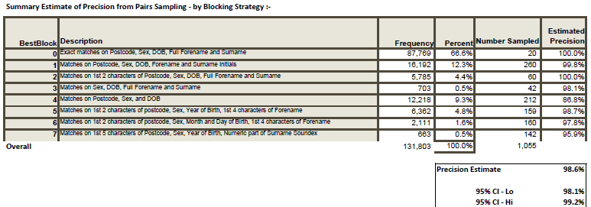
Care Home Census 2012-16 Linkage Quality

Slide 27
Care Home Census 2012-16 Potential Biases
Male: 89.9% v Female: 90.5%
YOB 1914-1990 Linkage Rate between 92% - 97% per year (no discernible trend)
Except 1950: 79.8%
SIMD no trend
Decile 5: 87.5% vs Decile 6: 92.2%

Slide 28
Care Home Census 2010-12 Data Quality
71,641 Input Records
~100% - valid postcode
99.9% - valid gender
58.0% - valid DOB (range 1902-1995)
4.1% DYOB= ‘01’ c.f. 3.3% expected
0.0% - filled names
57.9% - valid DOB/Sex/Pcode

Slide 29
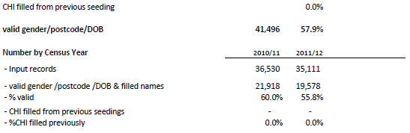
Care Home Census 2010-12 Data Quality continued

Slide 30

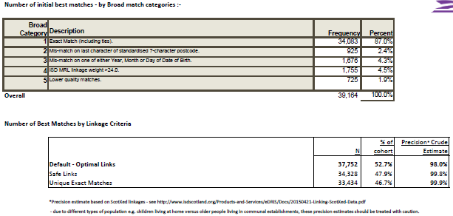
Care Home Census 2010-12 Linkage Quality

Slide 31
Care Home Census 2010-12 Potential Biases
Where all identifiers available: 90.9%
Male: 52.4% v Female: 52.9%
YOB 1900-1990 Linkage Rate between 85% - 95% per year (no discernible trend)
SIMD no trend
Decile 9: 46.0% vs Decile 7: 60.2%

Slide 32
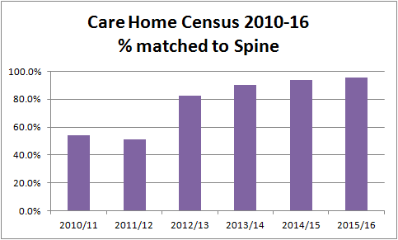
Linkage Summary by Year

Slide 33
Summary
Social Care Survey linkage of good quality but beware of holes – e.g. if analysing by council area.
Care Home Census – very good quality in latter years, very incomplete in earlier years.

Slide 34
Discussion and Questions
Dave Clark
eDRIS Team
dclark5@nhs.net
0131 275 6144
NRS Indexing Service
Indexing@nrscotland.gov.uk

